Slide 1



LOGICAL MODEL DESIGN – SHIPPING MANAGEMENT SYSTEM
Phase III – PL/SQL Capstone Project

Slide 2



Introduction
02
The logical data model for the Shipping Management System provides a structured representation of how data is organized and related within the system. It translates the real-world business processes defined in Phase II into formal entities, attributes, and relationships. This model ensures the system can effectively handle key functions such as customer order placement, warehouse operations, delivery routing, and feedback collection. By defining data elements like primary keys, foreign keys, and constraints (e.g., NOT NULL, CHECK), the model enforces business rules and supports data consistency across the platform.
The model has been designed following the principles of database normalization up to the Third Normal Form (3NF), ensuring that data is logically organized, free from redundancy, and easily maintainable. It supports real-time operational needs and prepares the system for scalable, reliable implementation in Oracle Database during the next project phase. This logical foundation is critical for enabling accurate data analysis, performance monitoring, and decision support—key pillars of any Management Information System (MIS).

Slide 3
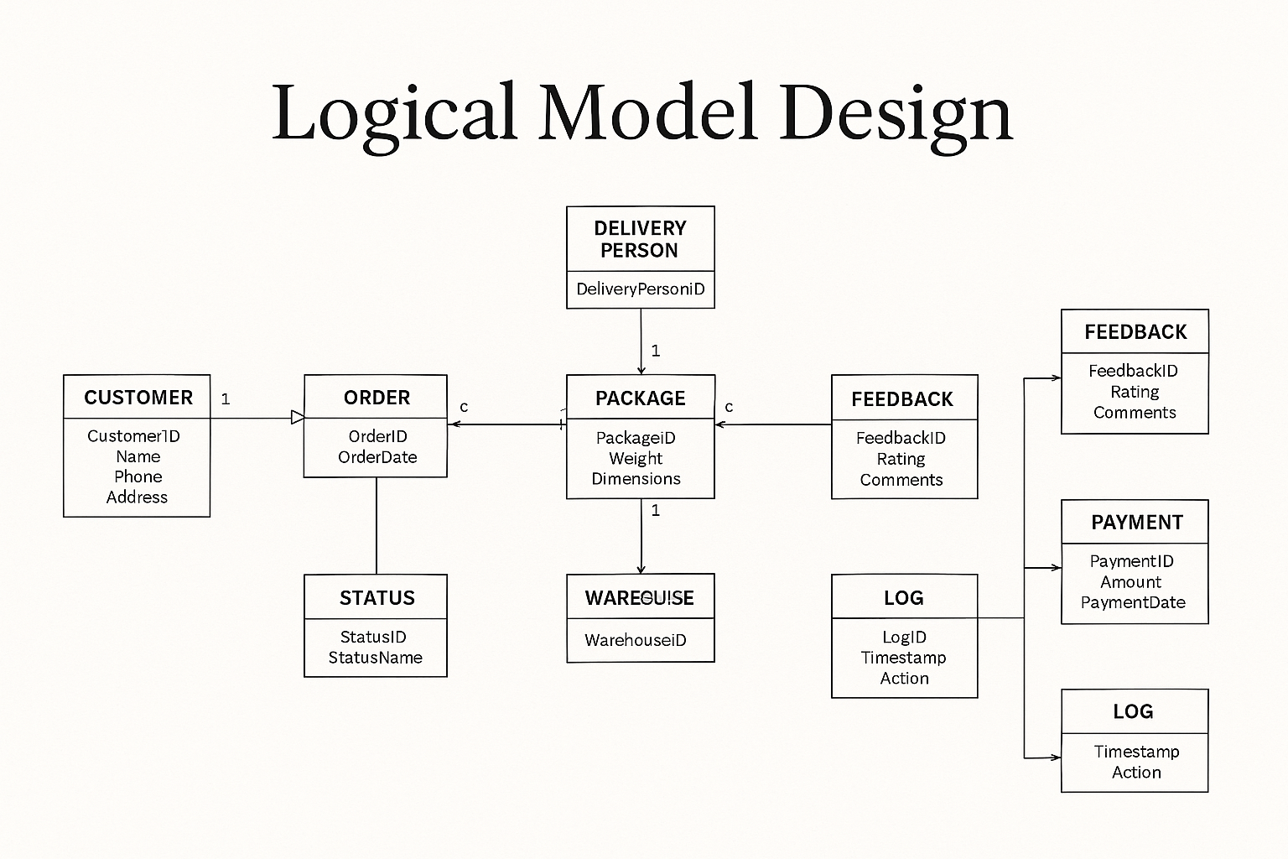
Logical Model Design
03

Slide 4

04
Entities
Customer
ShippingOrder
Package
Warehouse
DeliveryPersonnel
DeliveryRoute
Feedback

Slide 5


Entity : Customer
CustomerID (PK) – Unique identifier for each customer (NUMBER)
FullName – Full name of the customer (VARCHAR2)
Phone – Contact phone number (VARCHAR2)
Email – Email address (VARCHAR2, must be UNIQUE)
Address – Delivery address (VARCHAR2)
DateRegistered – Date the customer was added to the system (DATE)

Slide 6

ShippingOrder
06
OrderID (PK) – Unique identifier for each order (NUMBER)
CustomerID (FK) – Linked to the Customer placing the order (NUMBER)
WarehouseID (FK) – Linked to the warehouse processing the order (NUMBER)
OrderDate – Date when the order was placed (DATE)
ScheduledDeliveryDate – Expected delivery date (DATE)
TotalWeight – Combined weight of all packages in the order (NUMBER)
ServiceType – Type of shipping (e.g., Express, Standard) (VARCHAR2)
OrderStatus – Status of the order (Pending, In Progress, Completed) (VARCHAR2)

Slide 7

Package
PackageID (PK) – Unique ID for each package (NUMBER)
OrderID (FK) – Linked to the ShippingOrder it belongs to (NUMBER)
Weight – Weight of the package (NUMBER)
Dimensions – Size (Length x Width x Height) (VARCHAR2)
ContentDescription – Description of what’s inside (VARCHAR2)
Fragile – Boolean value (Yes/No) indicating if special care is needed (CHAR)
TrackingNumber – Unique shipment tracking number (UNIQUE) (VARCHAR2)

Slide 8
08
Warehouse
WarehouseID (PK) – Unique ID for each warehouse (NUMBER)
Name – Name or code for the warehouse (VARCHAR2)
Location – Physical location/address (VARCHAR2)
Manager – Name of the warehouse manager (VARCHAR2)
Capacity – Storage capacity or operational volume (NUMBER)

Slide 9

DeliveryPersonnel
09
PersonnelID (PK) – Unique ID for the delivery agent (NUMBER)
FullName – Full name (VARCHAR2)
Phone – Contact number (VARCHAR2)
AssignedWarehouseID (FK) – Warehouse to which they report (NUMBER)
VehicleNumber – Vehicle registration (VARCHAR2)
ShiftStart – Start of shift (TIME)
ShiftEnd – End of shift (TIME)

Slide 10

DeliveryRoute
06
RouteID (PK) – Unique route ID (NUMBER)
OrderID (FK) – Linked to the order being delivered (NUMBER)
PersonnelID (FK) – Linked to the delivery agent (NUMBER)
DepartureTime – Time the delivery vehicle leaves the warehouse (DATE/TIME)
EstimatedArrival – ETA at the customer location (DATE/TIME)
DistanceKM – Distance of the route (NUMBER)
Status – Route status (Active, Delayed, Completed) (VARCHAR2)

Slide 11
DeliveryStatus
StatusID (PK) – Unique ID for status event (NUMBER)
OrderID (FK) – Order the status belongs to (NUMBER)
Timestamp – When the status update was recorded (DATE/TIME)
Location – Where the package was at that time (VARCHAR2)
StatusType – e.g., “In Transit”, “Delivered”, “Failed” (VARCHAR2)
Remarks – Additional notes or scan codes (VARCHAR2)
Sales Presentation | December 2020

Slide 12
Feedback
FeedbackID (PK) – Unique ID for feedback record (NUMBER)
OrderID (FK) – Linked to the order (NUMBER)
Rating – Score from 1 to 5 (NUMBER with CHECK constraint)
Comment – Text feedback from the customer (VARCHAR2)
SubmittedOn – Date and time of feedback (DATE)

Slide 13
Payment
PaymentID (PK) – Unique ID for payment (NUMBER)
OrderID (FK) – Linked to the corresponding order (NUMBER)
Amount – Total payment amount (NUMBER)
Currency – Payment currency (e.g., USD) (VARCHAR2)
PaymentMethod – e.g., Credit Card, Mobile Money (VARCHAR2)
PaymentStatus – Paid, Pending, Failed (VARCHAR2)
PaymentDate – When payment was processed (DATE)

Slide 14
Key Relationships Between Entities
14
1 : Many (1:M)
Customer → ShippingOrder
A single customer can place multiple orders, but each order belongs to one customer only.
ShippingOrder → Package
One shipping order can contain many packages. Each package is associated with one order.
Warehouse → ShippingOrder
Each warehouse can process multiple orders, but an order is processed by only one warehouse.
DeliveryPersonnel → DeliveryRoute
One delivery person can be assigned to many delivery routes, but each route has only one assigned delivery person.
ShippingOrder → DeliveryStatus
One order can have many delivery status updates (in transit, delayed, delivered, etc.).
Many : 1 (M:1)
1 : 1 (One-to-One)
Package → ShippingOrder
Many packages may belong to one shipping order.
DeliveryRoute → DeliveryPersonnel
Multiple routes can be managed by the same delivery agent, especially across different dates.
ShippingOrder → Payment
Each shipping order has one payment record linked to it.
ShippingOrder → Feedback
Each order may have one feedback entry (optional).

Slide 15
15
NOT NULL:
Applied to essential fields like CustomerID, OrderDate, PaymentID, and TrackingNumber to ensure no important data is left blank.
UNIQUE:
Applied to TrackingNumber in the Package entity to prevent duplication of package tracking IDs.
CHECK:
Used in the Feedback entity to validate ratings:
CHECK (Rating BETWEEN 1 AND 5)
DEFAULT:
Fields such as OrderDate, SubmittedOn, and PaymentDate are assigned default values using DEFAULT CURRENT_DATE to auto-populate with the system date.
Constraints Applied in the Database

Slide 16
Normalization
The data model of the Shipping Management System has been carefully designed to follow the principles of database normalization, ensuring efficient storage, elimination of redundancy, and logical organization of data.
First Normal Form (1NF)
All tables have atomic (indivisible) values for each column.
There are no repeating groups or multivalued fields.
Example: Each package in the Package table has a single tracking number, description, and weight—no multiple entries in the same field.
Second Normal Form (2NF)
All non-key attributes depend entirely on the primary key.
There are no partial dependencies in any composite keys.
Example: In the ShippingOrder table, attributes like OrderDate, TotalWeight, and ServiceType depend only on the OrderID, not on just a part of it.
Third Normal Form (3NF)
There are no transitive dependencies (i.e., no field is dependent on another non-key field).
All attributes are directly dependent on the primary key and nothing else.
Example: In the Customer table, FullName, Phone, and Email all depend solely on CustomerID. No attribute depends on another non-key attribute.
Normalization Actions Taken
Feedback was separated from ShippingOrder into its own table to avoid mixing feedback data with operational data.
Payment details were isolated into the Payment entity to maintain financial data integrity.
Delivery status updates were normalized into a separate DeliveryStatus table to track multiple statuses over time instead of storing status history in the ShippingOrder table.

Slide 17
Summary of Phase III – Logical Model Design
A comprehensive Entity-Relationship Diagram (ERD) was developed to represent the data structure of the Shipping Management System.
All relevant entities—such as Customer, ShippingOrder, Package, Warehouse, DeliveryPersonnel, Payment, and Feedback—were identified and documented with clear attributes.
Primary keys and foreign keys were defined to establish relationships between entities, ensuring referential integrity.
Important constraints (NOT NULL, UNIQUE, CHECK, DEFAULT) were applied to enforce business rules and data accuracy.
The model adheres to Third Normal Form (3NF), ensuring that data is logically structured, redundant-free, and easy to maintain.
The design was evaluated against real-world data scenarios, including multi-package orders, delivery status updates, optional feedback, and route assignment.

